Slide 1
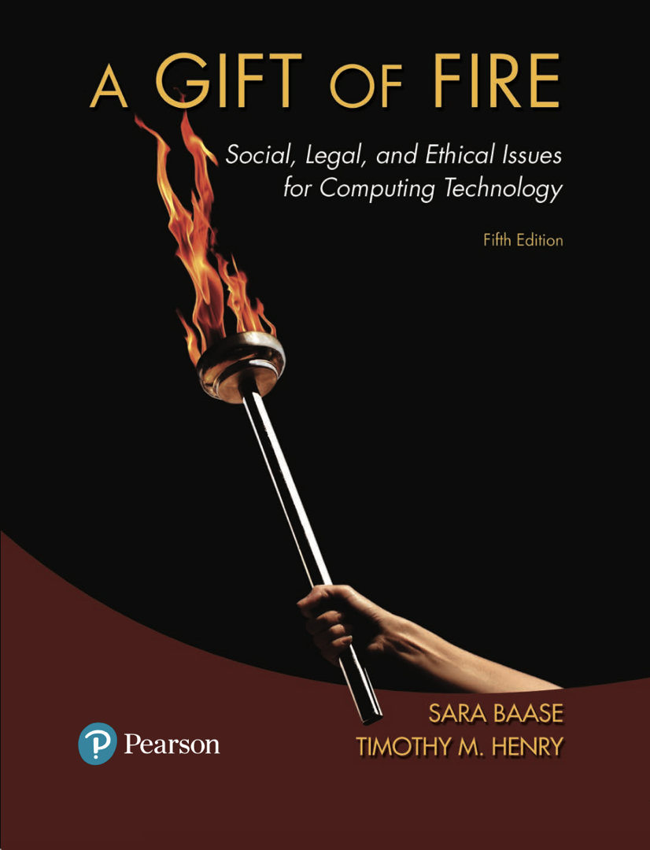
CMPS 310
Lecture 4
Chapter 2 Part 2:
Business+Social Sectors/
Based on slides prepared by Cyndi Chie, Sarah Frye and Sharon Gray.
Fifth edition updated by Timothy Henry

Slide 2

Privacy Risks and Principles
The Business and Social Sectors
The Fourth Amendment, Expectation of Privacy, and Surveillance Technologies
Government Systems
Protecting Privacy: Technology, Markets, Rights, and Laws
Communications

Slide 3

What we do
Post opinions, gossip, pictures, “away from home” status
What they do
New services with unexpected privacy settings
Notes:
Away from home: do you really want people knowing this??
People trying to clean up their online personas before starting a job search find that it is hard to eliminate embarrassing material.
When Facebook began telling members about purchases their friends made, problems ranged from spoiling surprise gifts to embarrassing and worrisome disclosures. Should Facebook introduce such features turned “on” for everyone? Or should the company announce them and let members opt in with a click?

Slide 4

Discussion Questions
Is there information that you have posted to the Web that you later removed? Why did you remove it? Were there consequences to posting the information?
Have you seen information that others have posted about themselves that you would not reveal about yourself?
Notes:
Quick Discussion

Slide 5

Security of online data
Who has access to your personal info, do random employees have access?
What rights do I have to preventing information from being sold? Can my name, age, and social security number be exchanged?
What are the companies’ security policies?
Convenience
Do I care if Facebook shares all of the pages that I like if it makes it easy to follow pages?

Slide 6

Global Positioning Systems (GPS) – computer or communication services that know exactly where a person is at a particular time
Cell phones and other devices are used for location tracking
Pros
Allows for services like Waitr and Maps
Cons
A profile of your general movement patterns might be out there

Slide 7
Tools for parents
GPS tracking via cell phones or RFID
Is it right for parents to be able to track their adolescent children at all times?

Slide 8

The right to have material removed.
negative right (a liberty)
I should be free from prying eyes
positive right (a claim right)
People should have ways to control public information about them
If a parent posts many photos of their child on Facebook growing up, should the child have the right to delete those photos and posts as they get older?

Slide 9
The Fourth Amendment

Slide 10

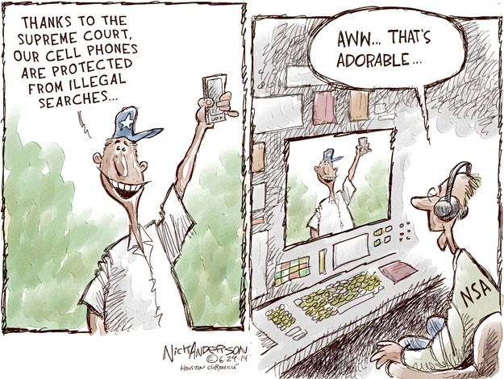

Slide 11
The right of the people to be secure in their person, houses, papers, and effects, against unreasonable searches and seizures, shall not be violated, and no Warrants shall issue, but upon probable cause, supported by Oath or affirmation, and particularly describing the place to be searched, and the persons or things to be seized.
—4th Amendment, U.S. Constitution

Slide 12
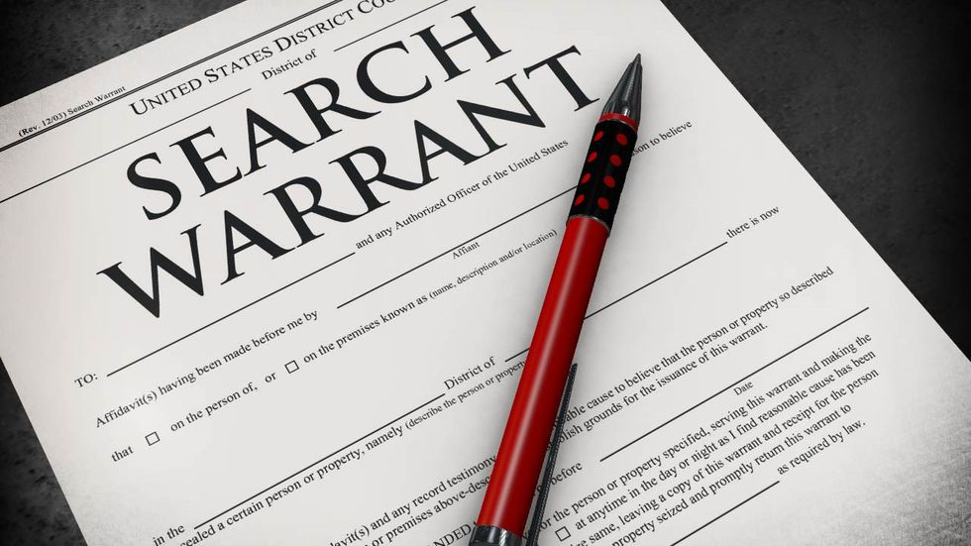
The Fourth Amendment

Slide 13
Sets limits on government’s rights to search our homes and businesses and seize documents and other personal effects. Requires government provide probable cause.
Two key problems arise from new technologies:
Much of our personal information is no longer safe in our homes; it resides in huge databases outside our control.
New technologies allow the government to search our homes without entering them and search our persons from a distance without our knowledge.
Notes:
All data on a cellphone (including deleted data and password protected data) can be extracted in less than two minutes at a traffic stop.
Govment may argue that 4th amendment does apply to data… but supreme court says no to that

Slide 14

Make possible “noninvasive but deeply revealing” searches
particle sniffers, imaging systems, location trackers
What restrictions should we place on their use? When should we permit government agencies to use them without a search warrant?

Slide 15

Olmstead v. United States (1928)
Supreme Court allowed the use of wiretaps on telephone lines without a court order.
Interpreted the Fourth Amendment to apply only to physical intrusion and only to the search or seizure of material things, not conversations.
Notes:
Justice Louis Brandeis dissented, arguing that the authors of the Fourth Amendment did all they could to protect liberty and privacy – including privacy of conversations – from intrusions by government based on the technology available at the time.

Slide 16
Communications Act(1934)
Congress put forward that no one could legally intercept and divulge a message (including law enforcement)
Notes:
Justice Louis Brandeis dissented, arguing that the authors of the Fourth Amendment did all they could to protect liberty and privacy – including privacy of conversations – from intrusions by government based on the technology available at the time.

Slide 17
Communications Act(1937)
Supreme Court said wiretapping violates communication act of 1934
Notes:
Police were still doing so w/o warrants sometimes

Slide 18
Katz v United States (1967)
Supreme Court reversed its position (from 1928) and ruled that the Fourth Amendment does apply to conversations.
Court said that the Fourth Amendment protects people, not places. To intrude in a place where reasonable person has a reasonable expectation of privacy requires a court order.
Notes:
JBM: a phone booth, for example, could be in public but privacy is expected
In this case, law enforcement had attached a listening and recording device on the outside of a telephone booth to record a suspect’s conversation.
Although Katz v United States strengthened the Fourth Amendment in some ways, there is a significant risk in relying on reasonable “expectation of privacy” to define the areas where law enforcement needs a court order. The Court has interpreted “expectation of privacy” in a very restrictive way. For example, it ruled that if we share information with businesses such as our bank, then we have no reasonable expectation of privacy for that information (United States v Miller, 1976). We share many kinds of personal information at specific Web sites where we expect it to be private. Is it safe from warrantless search?

Slide 19
ECPA (1986)
Electronic Communications Privacy Act
Extends 1967 restrictions to emails, cordless phones, etc
Does this apply to direct messages and other newer forms of communication?
Notes:
JBM: a phone booth, for example, could be in public but privacy is expected
In this case, law enforcement had attached a listening and recording device on the outside of a telephone booth to record a suspect’s conversation.
Although Katz v United States strengthened the Fourth Amendment in some ways, there is a significant risk in relying on reasonable “expectation of privacy” to define the areas where law enforcement needs a court order. The Court has interpreted “expectation of privacy” in a very restrictive way. For example, it ruled that if we share information with businesses such as our bank, then we have no reasonable expectation of privacy for that information (United States v Miller, 1976). We share many kinds of personal information at specific Web sites where we expect it to be private. Is it safe from warrantless search?

Slide 20
Kyllo v United States (2001)
Supreme Court ruled that police could not use thermal-imaging devices to search a home from the outside without a search warrant.
Court stated that where “government uses a device that is not in general public use, to explore details of the home that would previously have been unknowable without physical intrusion, the surveillance is a ‘search.’”
Notes:
This reasoning suggests that when a technology becomes more widely used, the government may use it for surveillance without a warrant.

Slide 21
Can your phone be searched by police?
They were doing so some years back as part of searching a person/vehicle
Supreme court ruled in 2014 that cell phones may not be searched without a warrant
However, police can inspect phone for physical weapons (knives embedded etc)
But your information is still free from intrusion
Notes:
JBM slide

Slide 22
Stingrays, etc
Stingrays and other variants of IMSI (International Mobile Subscriber Identity) catcher:
Agencies have been using them since at least 2009
Their operation and even existence are protected by nondisclosure agreements supported by the federal government
May be called “confidential sources”
Can locate phones and monitor traffic
Notes:
JBM slide

Slide 23

Security cameras
Increased security
Can possibly help detect intruders or catch burglars on video
Decreased privacy
A professor might not want footage of the bar they attend put in a place that students can see (or vice versa)
We may feel that we are unwittingly being subjected to a “police checkpoint”
Notes:
Police in Tampa, Florida, scanned the faces of all 100,000 fans and employees who entered the 2001 Super Bowl (causing some reporters to dub it Snooper Bowl) to search for criminals. People were not told that their faces were scanned.
Some cities have increased their camera surveillance programs, while others gave up their systems because they did not significantly reduce crime. (Some favor better lighting and more police patrols – low tech and less invasive of privacy.)
England was the first country to set up a large number (millions) of cameras in public places to deter crime. A study by a British university found a number of abuses by operators of surveillance cameras, including collecting salacious footage and showing it to colleagues.

Slide 24

Databases:
Government Accountability Office (GAO) - monitors government's privacy policies
Burden of proof and "fishing expeditions"
Data mining and computer matching to fight terrorism

Slide 25
Public Records: Access vs. Privacy:
Public Records – records available to general public (bankruptcy, property, and arrest records, salaries of government employees, etc.)
Identity theft can arise when public records are accessed
How should we control access to sensitive public records?

Slide 26
Discussion Questions:
What data does the government have about you?
Who has access to the data?
How is your data protected?

Slide 27

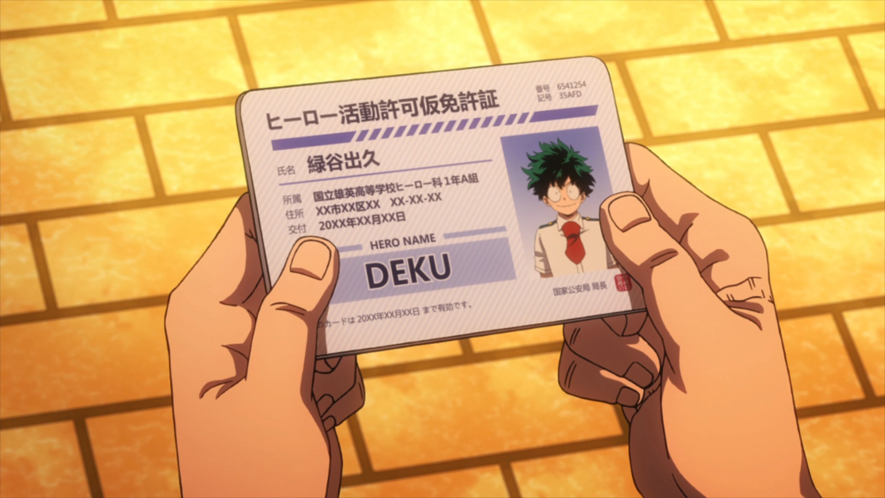
National ID Systems

Slide 28

Social Security Numbers
Too widely used
Easy to falsify
Various new proposals would require citizenship, employment, health, tax, financial, or other data, as well as biometric information. In many proposals, the cards would also access a variety of databases for additional information.
Notes:
National ID systems began in U.S. with the Social Security card in 1936.
Opponents of national ID systems argue that they are profound threats to freedom and privacy. “Your papers, please” is a demand associated with police states and dictatorships.

Slide 29
A new national ID system - Pros
would require the card
harder to forge
have to carry only one card
A new national ID system - Cons
Threat to freedom and privacy
Increased potential for abuse
What about biometric based ID systems?
Notes:
The REAL ID Act, passed in 2005, requires that in order to get a federally approved driver’s license or ID card, each person must provide documentation of address, birth date, Social Security number, and legal status in the U.S.

Slide 30

Technology and Markets:
Privacy enhancing-technologies for consumers
Encryption
the process of converting information or data into a code, especially to prevent unauthorized access.
Public-key cryptography
A checksum is a sequence of numbers and letters used to check data for errors. If you know the checksum of an original file, you can use a checksum utility to confirm your copy is identical.
Business tools and policies for protecting data

Slide 31

Warren and Brandeis: The inviolate personality
“The Right to Privacy”
Slander and libel aren’t enough to protect privacy
We have the right to be left alone
Surveillance violates property rights
If a neighbor hears a couple arguing, and submits the information to a gossip column, the column must not publish the information.
Notes:
Until the late 19th century, courts based legal decisions supporting privacy in social and business activities on property rights and contracts. There was no recognition of an independent right to privacy. In 1890, Samuel Warren and Louis Brandeis (later a Supreme Court Justice), wrote a crucial article in which they argued that privacy was distinct from other rights.
Judith Jarvis Thomson, and MIT philosopher, argued that the old view was more accurate, that in all cases where infringement of privacy is a violation of someone’s rights, that violation is of a right distinct from privacy.

Slide 32
Judith Jarvis Thomson: Is there a right to privacy?
All privacy violations can be chalked up to a violation of another right
Someone observing a private letter in their neighbor’s apartment by peeping in the window violates the ownership right of the letter owner
The property rights are waived if that same letter is left on a public bench
Voyeurism violates our right to have control over who sees our bodies
Notes:
Until the late 19th century, courts based legal decisions supporting privacy in social and business activities on property rights and contracts. There was no recognition of an independent right to privacy. In 1890, Samuel Warren and Louis Brandeis (later a Supreme Court Justice), wrote a crucial article in which they argued that privacy was distinct from other rights.
Judith Jarvis Thomson, and MIT philosopher, argued that the old view was more accurate, that in all cases where infringement of privacy is a violation of someone’s rights, that violation is of a right distinct from privacy.

Slide 33
Homework
Should organizers at events which are possible terrorist targets use video surveillance systems to identify potential targets?
Explain the difference between opt-in and opt-out policies for secondary uses of personal information.

Slide 34
Homework
One of the risks associated with databases of personal information is that criminals steal and use the information. How is this statement similar to and how does it differ from saying, “One of the risks associated with buying an expensive car is that criminals steal them”? Can you draw any useful insights from the analogy?

Slide 35
Homework
Under what circumstances, if any, do you think a person should ask for another person’s permission before posting a photo or video that the other person is in? When is it simply a courtesy, and when is it an ethical obligation? Explain your reasons.

Slide 36
Homework
Give an explanation, with examples and/or analogies, to describe what it means for privacy to be a negative right (liberty). Do the same for privacy as a positive right (claim right). (See Section 1.4.2 for explanations of negative and positive rights.) Which kind of right, if either, seems more appropriate for privacy? Why?

